Slide 1
Code Refactoring
Farjad Waseem

Slide 2
Introduction
At Code refactoring is a disciplined technique for restructuring existing code without changing its external behavior. The primary goal of refactoring is to improve the design, readability, and maintainability of the code. It involves making changes to the internal structure of the code to enhance its overall quality without altering its functionality.

Slide 3



Code Refactoring
Process of restructuring existing code
Readable maintainable
Efficient
Without alterations making the codebase better

Slide 4

Objectives
Improve Code Quality
Enhancing Maintainability
Facilitating Collaborations
Reducing Technical Debts
Performance Optimization

Slide 5
Common Refactoring Techniques
Extract Method
Rename Variable/ Method/Class
Extract Class
Replace Conditional with Polymorphsim
Remove Code Duplication

Slide 6
Refactoring Process
Identify Code Smells
Plan Refactoring
It refers to the potential issues in the code. They can include duplicated code, long methods, unclear variable names
Understand the existing code, plan for specific improvements, what refactoring techniques to apply
Write Tests
Review and Iterate
Before Refactoring, ensure you have proper testing mechanisms
Review the refactored code seek Feedback from team members

Slide 7
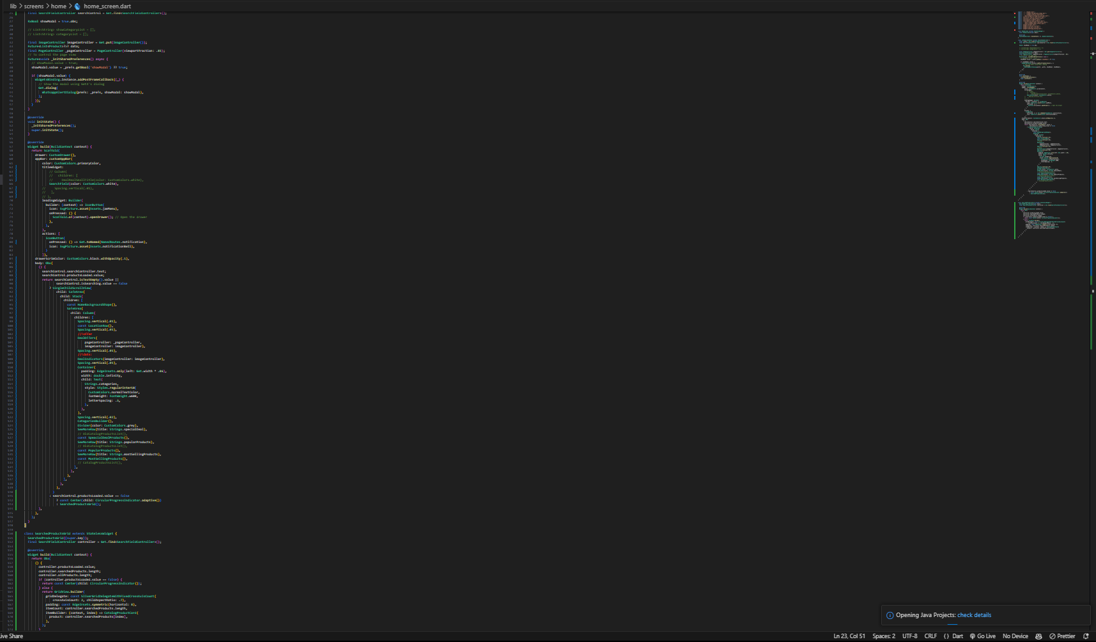
OUR COMPETITION
CONVENIENT
Contoso
A
Too redundant and unreadable
code
EXPENSIVE
AFFORDABLE
D
C
E
B
INCONVENIENT

Slide 8
Advantages of Code Refactoring

Slide 9
Advantages
Improved Readability
Maintainability
Clear naming conventions, modular structures, and consistent formatting is easier for developers to understand. Also facilitates collaboration.
Code maintainability improves code by restructuring the code to be more modular and understandable.
Flexibility and Adaptability
Better Collaboration
Refactored code is more flexible and adaptable to because of modular structure
A well-structured and modularized code with proper comments improves collaborations

Slide 10
THANK YOU
Farjad Waseem
+92-302-402-6030
Farjad.waseem@studentambassadors.com
www.menuspk.com/

